Slide 1


THE ESSENTIALS OF FINANCE

Slide 2



Be respectful…
Be humble…
Be curious…
Be engaged...
Learn one thing!
Leave with a plan of learning more!
Expectations

Slide 3
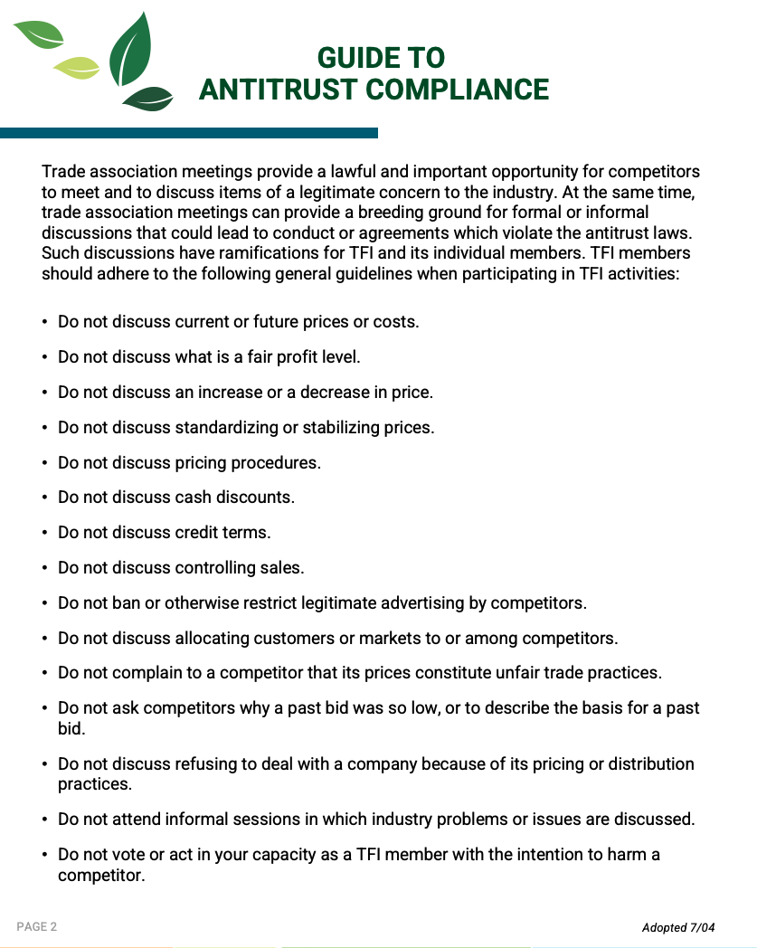
GUIDE TO ANTITRUST COMPLIANCE
Please reference Page 2 of your Workbook.

Slide 4
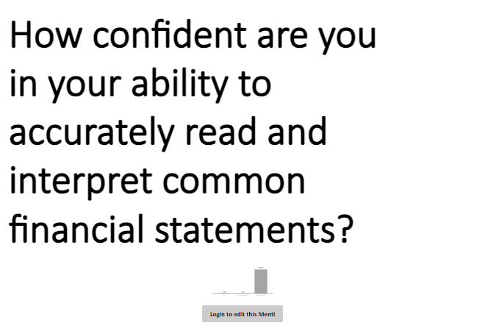
QUIZ TIME!
Follow the QR code to a survey

Slide 5
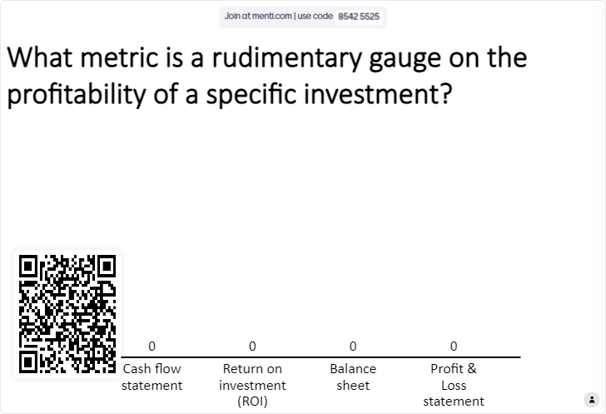
QUIZ TIME!
Follow the QR code to a survey

Slide 6
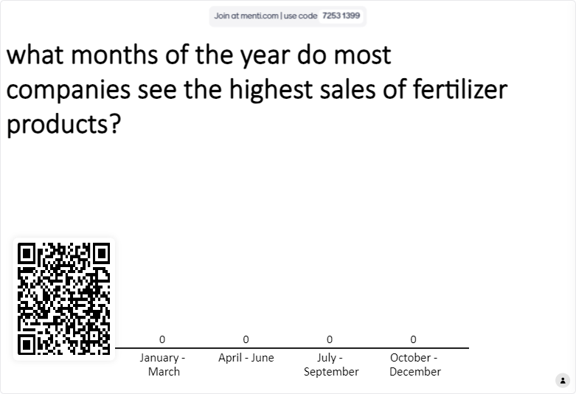
QUIZ TIME!
Follow the QR code to a survey

Slide 7
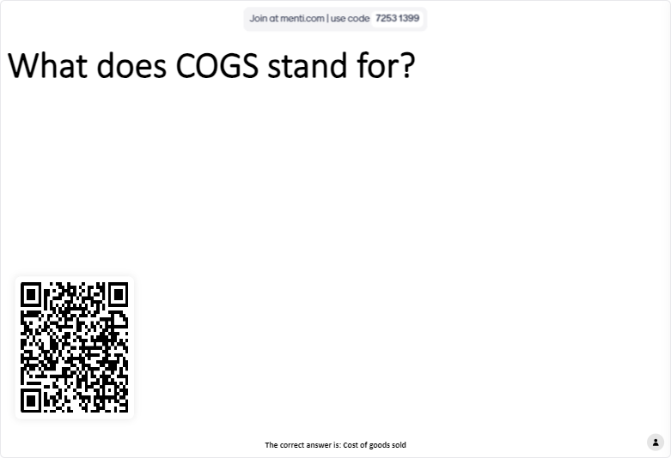
QUIZ TIME!
Follow the QR code to a survey

Slide 8
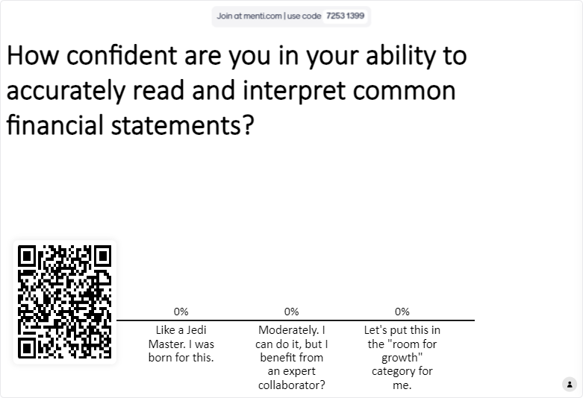
QUIZ TIME!
Follow the QR code to a survey

Slide 9
What is it?
Why is it used?
What is it a good tool for?
What is it not good for or what are its limitations?
Common Financial Metrics
For your assigned item, answer these questions…

Slide 10
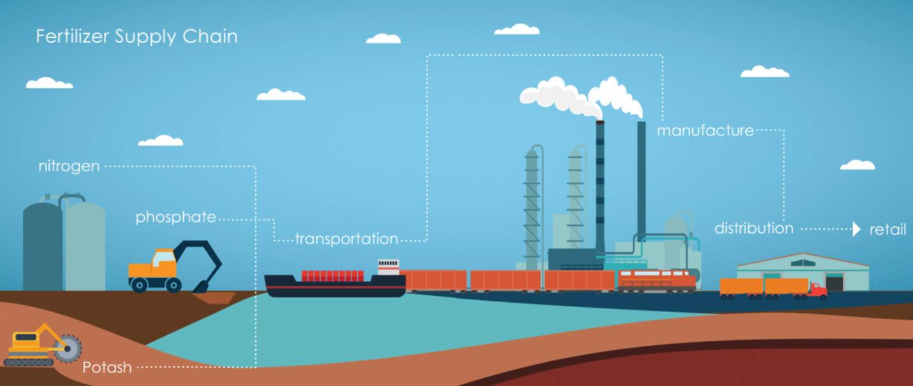
Fertilizer Supply Chain

Slide 11

Write as many expenses as possible for each step in the supply chain
Common Expenses
2

Slide 12

Tug of War

Slide 13
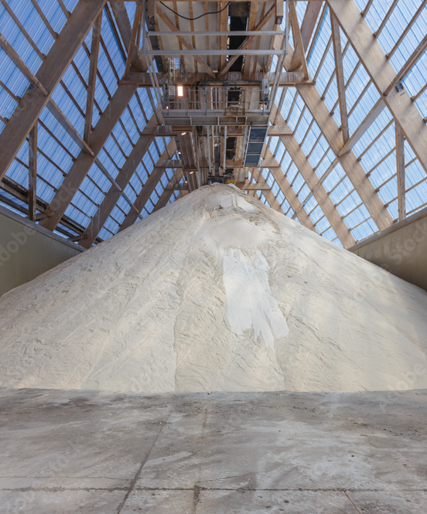
Trade Factors
What challenge or effect does each force have on the industry?
  Rapid Supply Needs
  Energy Cycles
  Seasonality
  Weather
  Boom and Bust Cycles
  Supply Chains
  Public Policy
SUPPLY SIDE
DEMAND SIDE
SWINGS &
ADJUSTMENTS

Slide 14

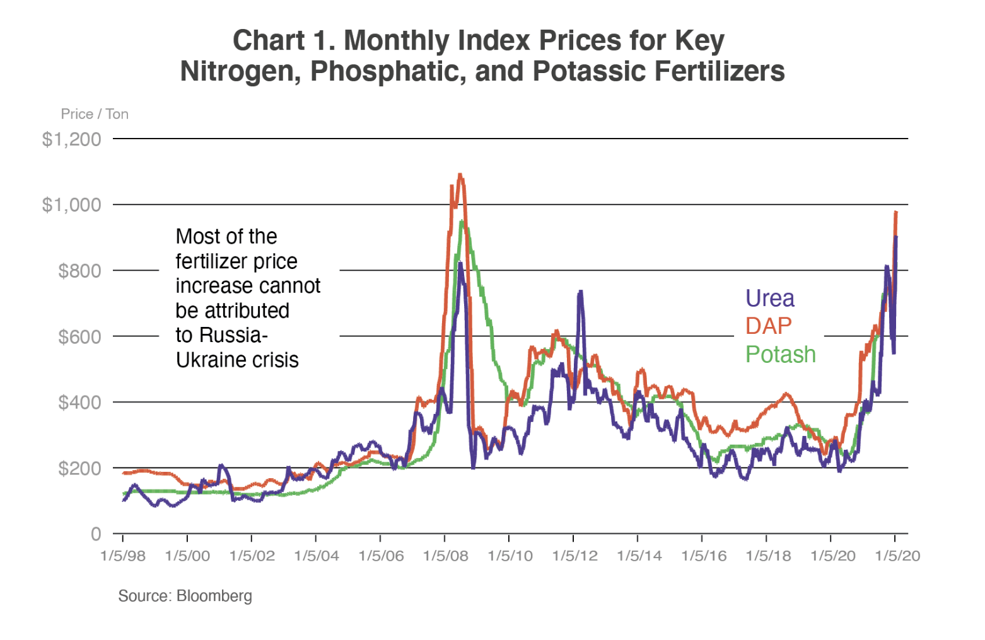
Trade Factors
A Historical Look at Fertilizer Prices

Slide 15

REMINDER
Create a calendar reminder according to the action items listed in your Workbook.

Slide 16

I have a personal example where I caught a fraud issue just because I reviewed the P&L and asked questions when something didn't seem right. Just another reason why it is so important to have an understanding of a P&L.”

Slide 17
We had an employee at a location not check the mail for two weeks and had $2 million worth of prepay waiting. It cost roughly $4k to the company just because the employee didn't check the mail. Large companies could replicate this over and over and the numbers could be a huge expense.

Slide 18
Closing
#TFIFertilizers – share your experience on social media!

Slide 19
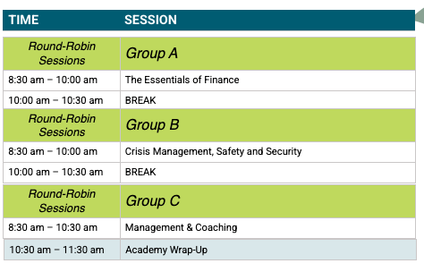

Preview: Day 3

