Slide 1
FERTILIZER 101

Slide 2
Please keep phones on silent.
Drinks
Restrooms
Be engaged!
Expectations

Slide 3
Catch Phrase!
Elect one person to be the timekeeper.
In 30 seconds, try to guess the word WITHOUT using “rhymes with,” “starts with,” or any part of the word/phrase itself.
Tally each correct answer.

Slide 4
TFI Sustainability Report
From 2019 through 2021, fertilizer companies invested an average of $1.19 billion annually in capital investments to help the industry meet sustainability goals. These investments increase production efficiencies, reduce energy and water use, reduce greenhouse gas emissions, and strengthen the U.S. economy to meet current and future agricultural needs.

Slide 5
Feeding the soil is the first step to feeding us all
-David R. Montgomery

Slide 6
SOIL HEALTH
Plant Productivity
Nutrient Cycle
Food Security
Soil Fertility
FERTILIZER

Slide 7
N, P, or K?
Browse the image gallery of nutrient deficient plants in the Fertilize 101 section.
Table Discussion
As a group, determine what nutrient the plant likely needs.
TIP! Use your workbook as a reference and lean on the group’s collective knowledge

Slide 8
Fertilizer Supply Chain

Slide 9
GLOBAL MARKET FOR FERTILIZER
Who Uses Fertilizer?

Slide 10
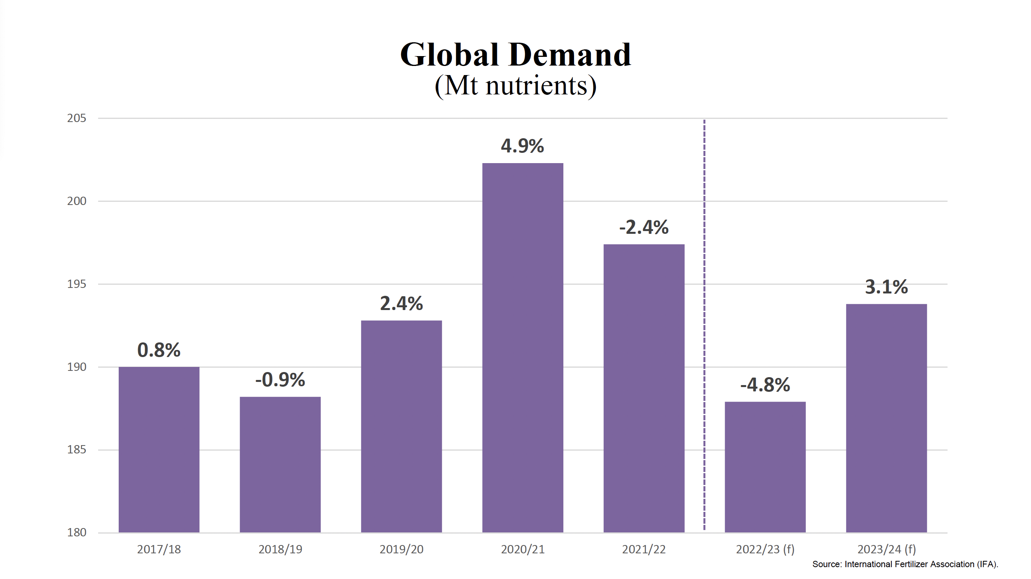
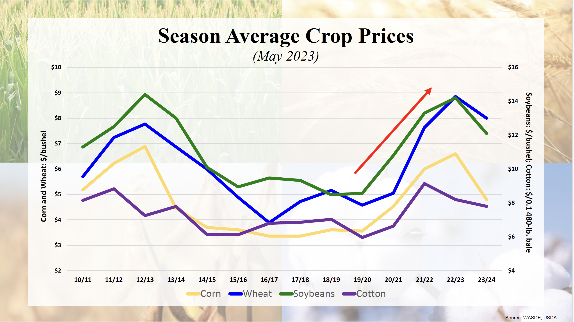
GLOBAL MARKET FOR FERTILIZER
Is Demand Cyclical/Seasonal?

Slide 11
GLOBAL MARKET FOR FERTILIZER
Where is Fertilizer Produced?

Slide 12
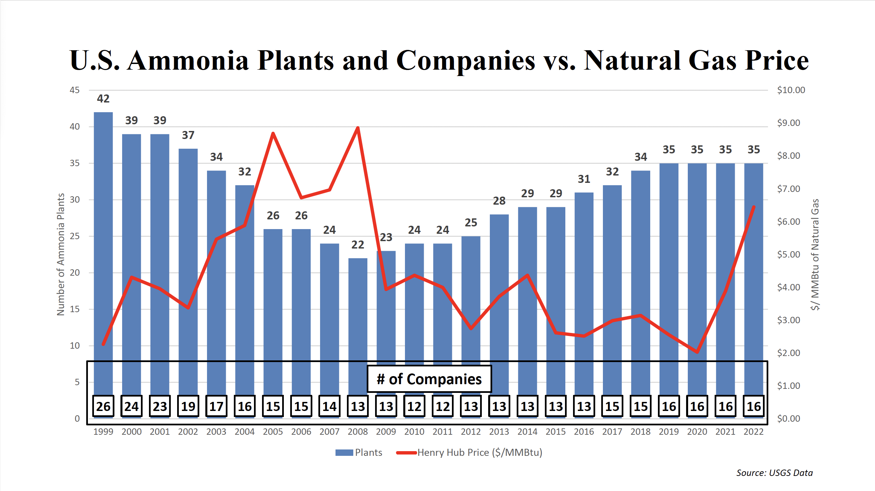
GLOBAL MARKET FOR FERTILIZER
What is the Connection to Natural Gas?

Slide 13
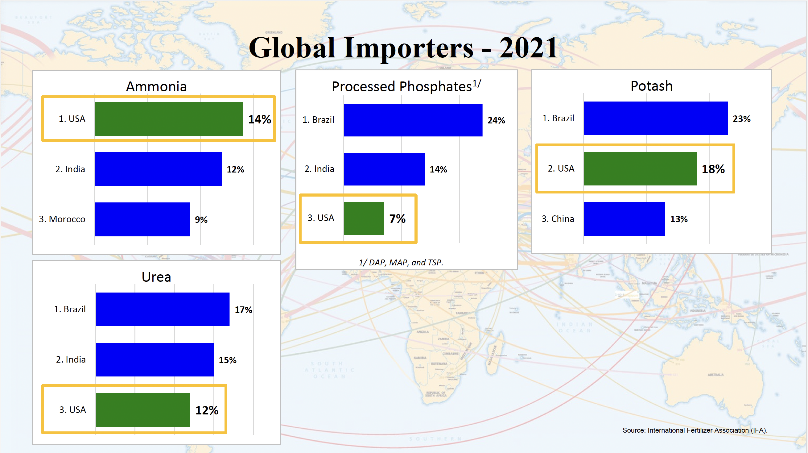
GLOBAL MARKET FOR FERTILIZER
Who is Buying Fertilizer?

Slide 14
Back to the Soil

Slide 15
Topsoil. It’s the most fertile part of the land, yet it only goes down a few inches. And these precious few inches are where our crops get the nutrients they need to grow. They are also some of the very nutrients we will eventually eat to stay healthy.
From TFI Website

Slide 16
Closing
#TFIFertilizers – share your experience on social media!

