Slide 1


CRISIS MANAGEMENT, SAFETY & SECURITY
Notes:
FACILITATOR: Prep the two videos, especially the one on Slide 5 as it requires navigating to webpage vs. in the presentation.

Slide 2



Please keep phones on silent.
Drinks
Restrooms
Be engaged!
Expectations

Slide 3




Shipwrecked! What will you do?
Choose six items for your group to keep.
Cross out three of your choices.
How do you plan to treat each person immediately and in a few days?
What does your help message say?

Slide 4
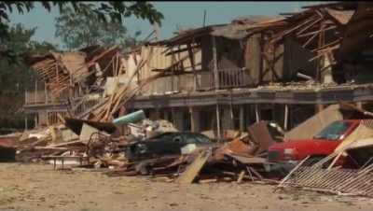
Notes:
Play 1:06-5:07
https://www.csb.gov/west-fertilizer-explosion-and-fire-/
https://youtu.be/pdDuHxwD5R4?si=8gOyhKdTNpbPxNvn&t=63

Slide 5
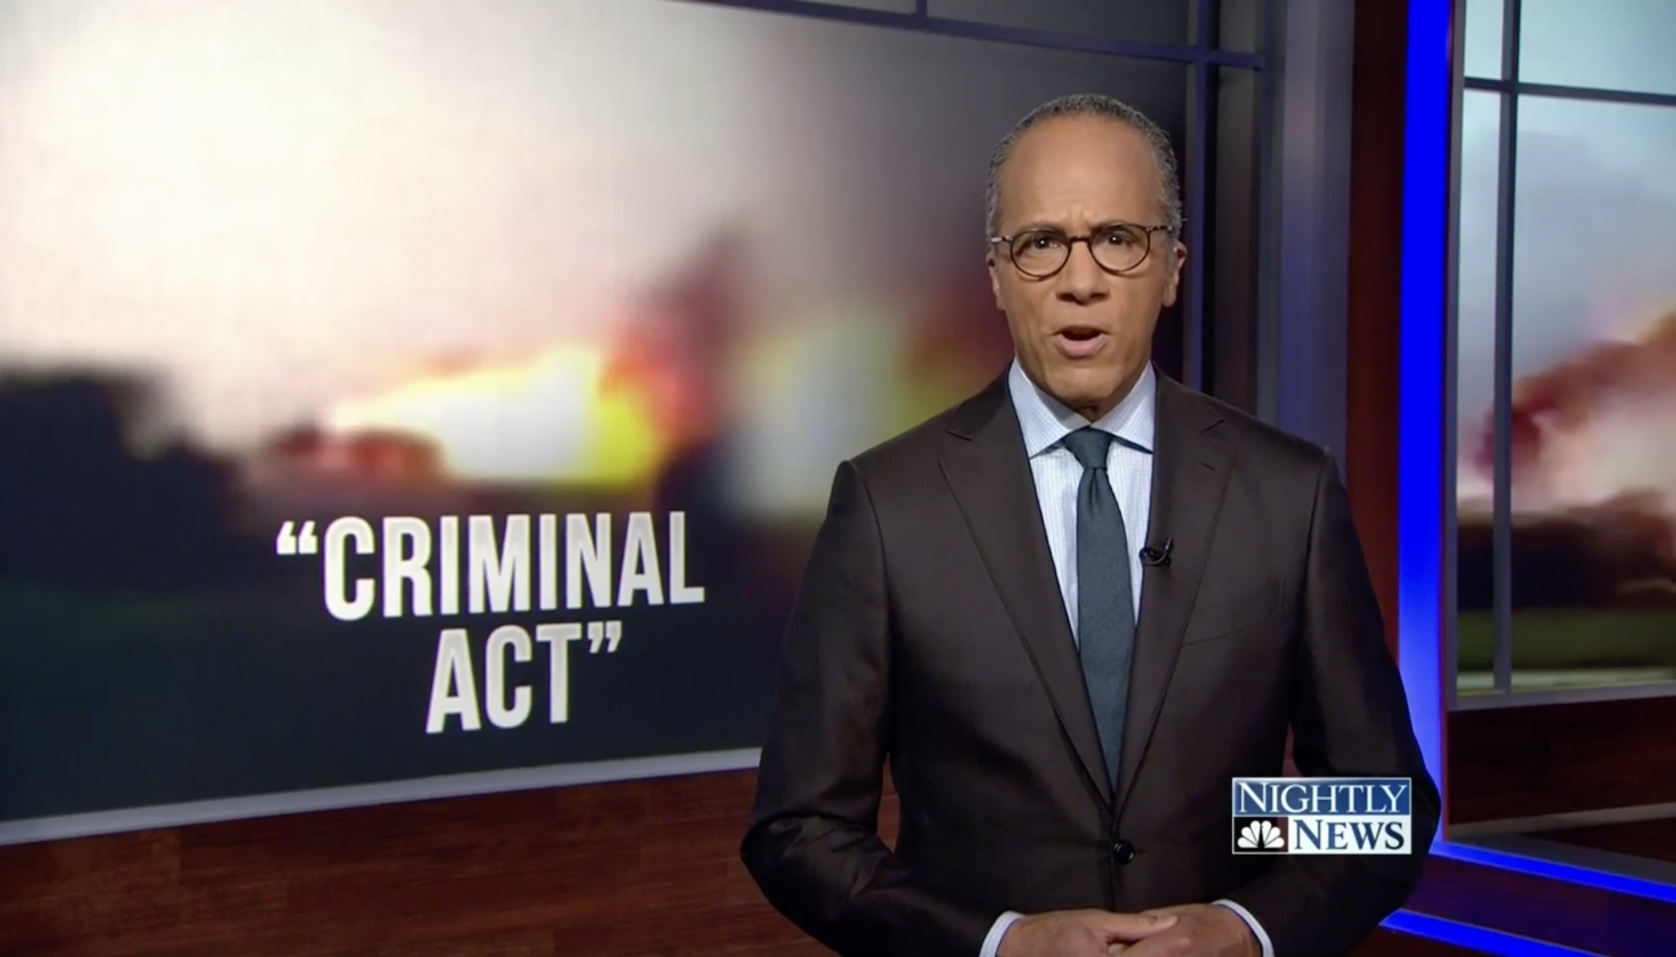
Notes:
FACILITATOR: Cue this page and prep video to be passed the ad that will likely play at beginning. https://www.nbcnews.com/news/us-news/deadly-west-texas-fertilizer-plant-explosion-was-criminal-act-feds-n572231

Slide 6



Does the determination that this was a deliberately set fire change your perception of the incident? Why or why not?
In addition to devastating the people and communities directly impacted, what do these kinds of events do to public trust and perception of the industry and/or its leaders?
Pair Share

Slide 7

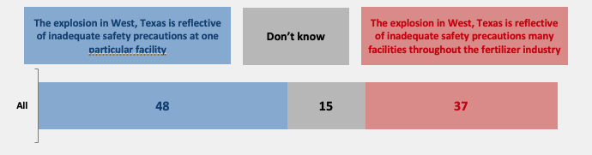
A Call for Change:
Polling Data After the Incident
Question: Which of the following is closer to your view? Showing All
The explosion in West, Texas is reflective of inadequate safety precautions at one particular facility.
The explosion in West, Texas is reflective of inadequate safety precautions many facilities throughout the fertilizer industry.
The incident occurred in April 2013. This poll was conducted in September 2013.
Respondents: Who was asked? It says MO, DC, and Texas “Elites” but what does that mean?

Slide 8
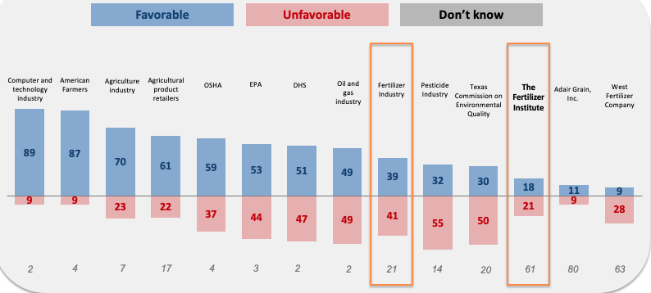
A Call for Change:
Polling Data After the Incident
Question: Do you have a very favorable, somewhat favorable, somewhat unfavorable, or very favorable view of these organizations or people? Showing All, Baseline Favorability

Slide 9
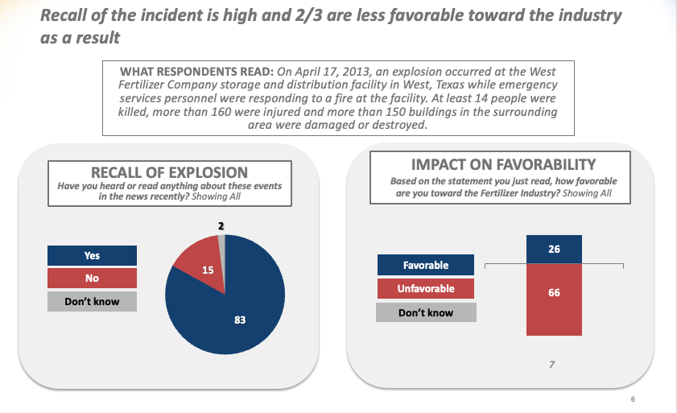
A Call for Change:
Polling Data After the Incident
Recall of the incident was high and 2/3 were less favorable toward the industry as a result.
What Respondents Read:
On April 17, 2013, an explosion occurred at the West Fertilizer Company storage and distribution facility in West, Texas while emergency services personnel were responding to a fire at the facility. At least 14 people were killed, more than 160 were injured and more than 150 buildings in the surrounding area were damaged or destroyed.

Slide 10
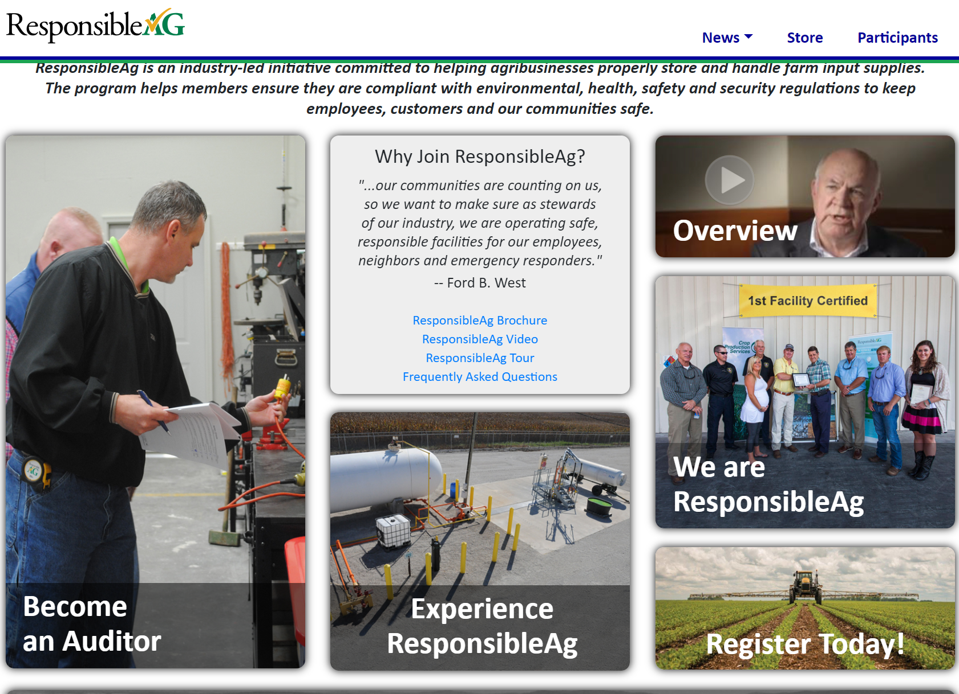
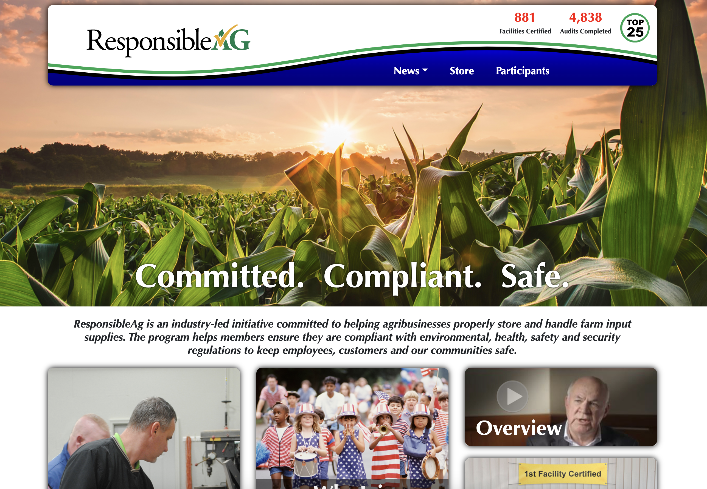

In response to the West, Texas incident, several proactive measures have been taken.
View more of TFIs resources online
Notes:
FACILITATOR: Consider navigating in real time to ResponsibleAg.org to demo.

Slide 11


Consider what safety means
Visually depict as a badge, logo, or graphic to represent a “Culture of Safety” in your organizations
A Culture of Safety

Slide 12



TEARSHEET BRAINSTORM
Add safety programs, trainings, etc. that you are familiar with

Slide 13

Safety is not a competitive advantage. We must help each other become a safer industry.

Slide 14
As an industry, how can we work together to better prevent and respond to crisis?
How can we better hold each other accountable?
Accountability Starts Here

Slide 15
Closing
#TFIFertilizers – share your experience on social media!

