Slide 1


AGRONOMY & STEWARDSHIP

Slide 2



Please keep phones on silent
Drinks:
Restrooms:
Be engaged!
Expectations

Slide 3


Between 1965 and 2015, world grain production rose from less than 0.6 tons per harvested acre to more than 1.4 tons.
Today, total global production is approximately 2.3 BILLION metric tons.
Essentially, we’re able to grow more than twice as much food on a single acre than we could 40 years ago.

Slide 4

What is Sustainability?
Increase food production in an economically viable way while retaining the ecological integrity of food systems.
Sustainable Agriculture
Sustainable fertilizer use must enhance the performance of the plant system and adhere to the 4Rs

Slide 5
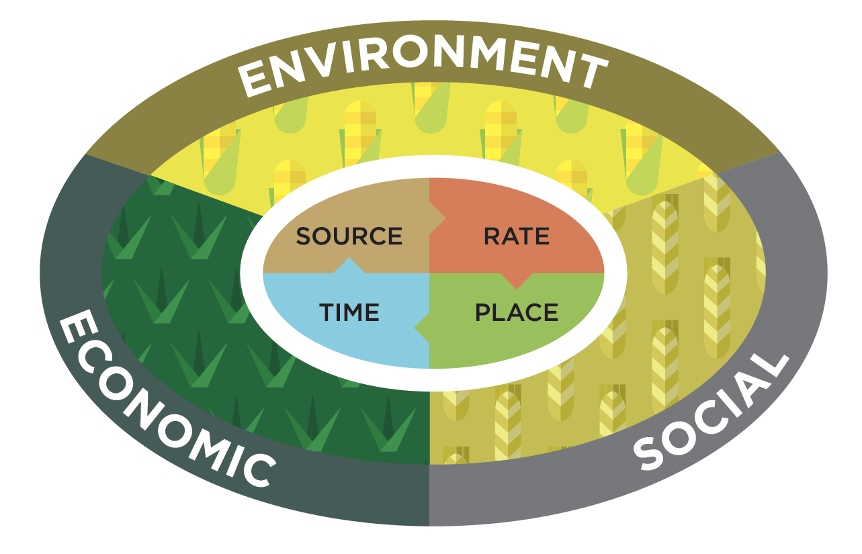

protect the environment • remain profitable • contribute to society

Slide 6
Describe the 4Rs (Source, Rate, Time, Place) in your own words.
Be prepared to share.
Defining the 4Rs

Slide 7

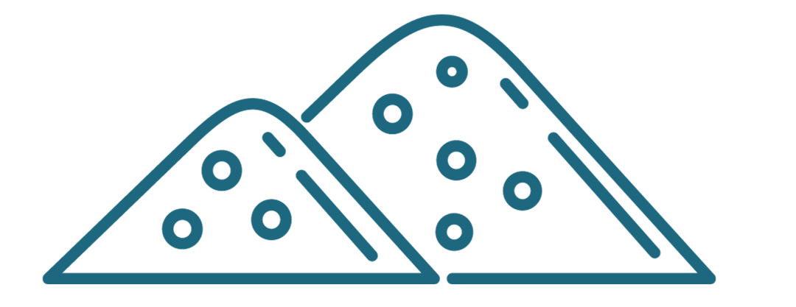


The 4 “Rights”
Right Source
Ensure a balanced supply of essential nutrients, considering both naturally available sources and the characteristics of specific products, in plant-available forms.
Right Rate
Assess and make decisions based on soil nutrient supply and plant demand.
Right Time
Assess and make decisions based on the dynamics of crop uptake, soil supply, nutrient loss risks, and field operation logistics.
Right Place
Address root-soil dynamics and nutrient movement and manage spatial variability within the field to meet site-specific crop needs and limit potential losses from the field.

Slide 8
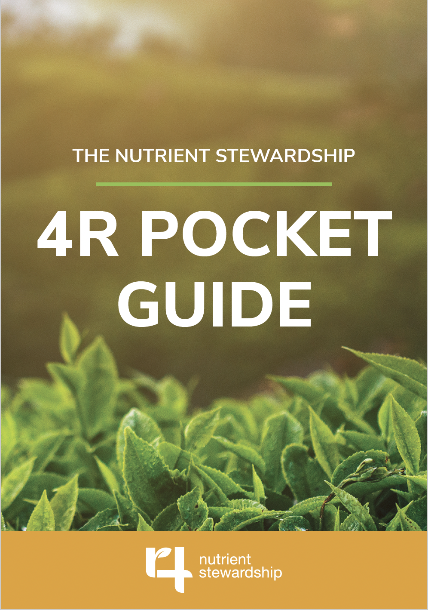



Flip Through & Find:
Exclamation Points: things you value or appreciate about the resource
Question Marks: things you don’t understand yet

Slide 9

Getting the 4Rs “right” depends on factors like:
  Soil composition, texture, and structure
  Crop type and genetic yield potential
  Available technology and support systems
  Climate & weather, including solar radiation
Table Discussion
Which of these factors you think is the
most challenging when trying to achieve the 4R’s? What are low-cost or efficient ways to address those challenges

Slide 10
x4
Add new thoughts
React with checkmarks or circles
Add to other’s statements
Pose questions
Chalk-N-Talk

Slide 11



Choose ONE Case Study as a team:
Find links to all three here:
Strip-Till and No-Till Corn Illinois
Florida Tomatoes
Louisiana Cotton

Slide 12
Closing
#TFIFertilizers – share your experience on social media!

