Slide 1
ADVOCACY
Cameron Bishop
Head of Washington Office
Federal and International Government Relations
J.R. Simplot Company
TFI Government Affairs Committee, Chair

Slide 2
Please keep phones on silent.
Be engaged!
Expectations

Slide 3
ADVOCACY
Cameron Bishop
Head of Washington Office
Federal and International Government Relations
J.R. Simplot Company
TFI Government Affairs Committee, Chair
Who Am I?

Slide 4
What is Advocacy?
Lobbying
Persuasion
Sales
Pressure
Promotion
Politics
Policy
Motivation
Influence
Guidance
Education

Slide 5
4 Traits of Leaders
TRUST
COMPASSION
STABILITY
HOPE

Slide 6
GOAL: Be Truthful and Effective
Strong advocacy means we share what we know to be true, demonstrate empathy and compassion to questions and concerns, and actively listen to others to create authentic dialogue.

Slide 7
Tips & Advice
Be honest and genuine. Admit to what you don’t know!
Be an educator and a storyteller.
Speak naturally, slowly, and steadily and allow your counterparts to engage in dialogue.
Stick to one pitch per occasion to keep it easy to understand.
Don’t grandstand to others to demonstrate you are in the right and have all the answers. Be humble and approachable.
BONUS: Know your audience before entering the meeting!

Slide 8
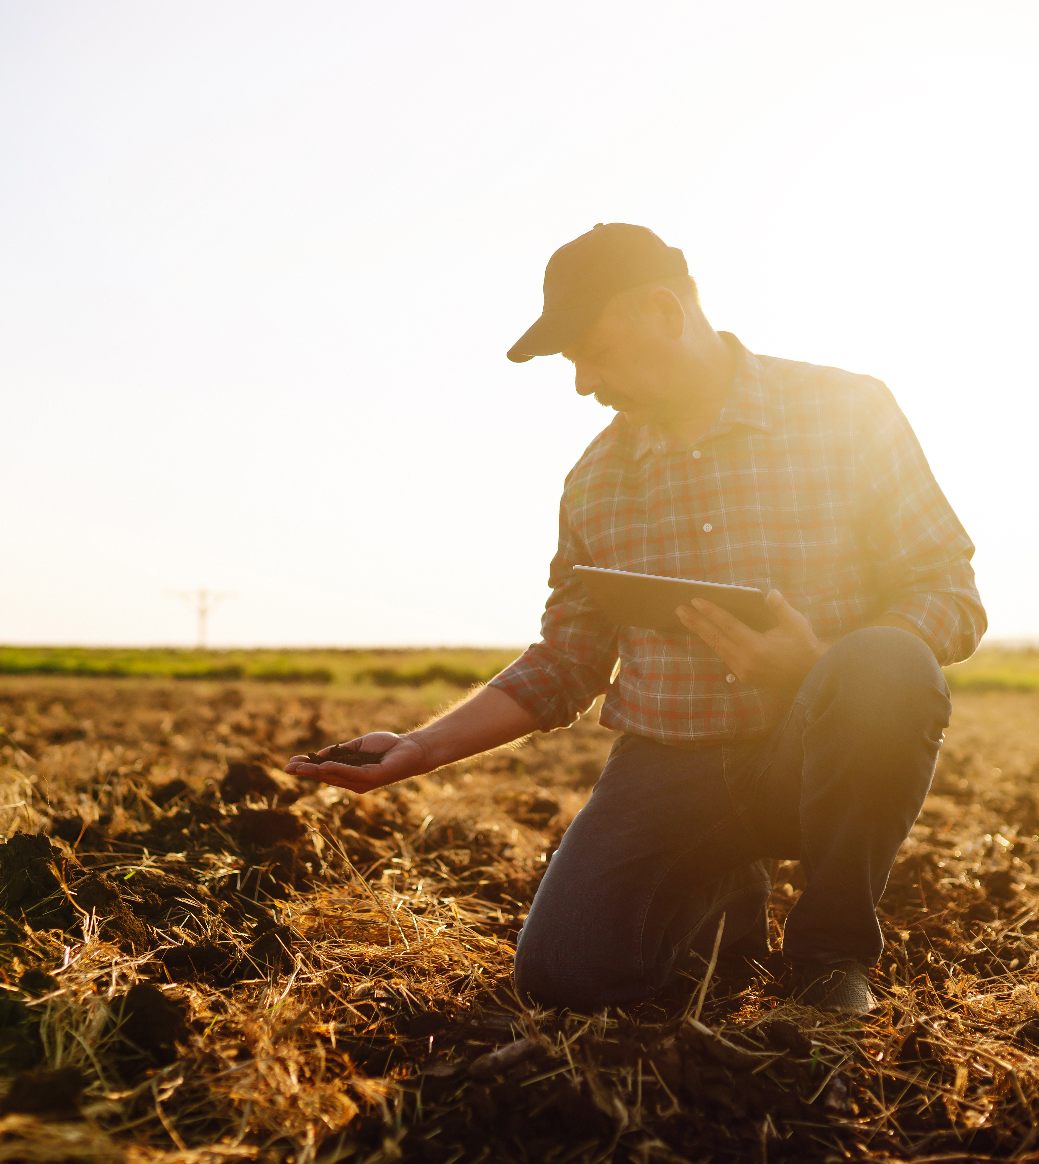
The Goal of an Elevator Speech
30 – 60 seconds
Roughly 75 words
Help build trust

Slide 9
Resources Brainstorm
Where else can we go to find reliable and accurate information regarding fertilizer hot topics and key issues?

Slide 10
Crafting the Pitch
Write a draft – under 60 seconds
Swap the written version with a partner for feedback
Then, practice delivering your pitch with a different partner
Use the template on the “Your Elevator Pitch” of your Workbook

Slide 11
Breakout Groups:
What is the Fertilizer Industry?
What do we do?
Quickly touch on the products made by the industry.
Why is it important?
Captivate your audience with why this product is needed.
Why should your audience care?
Answer why you are talking to this person about your industry and how they can be involved.

Slide 12
Hot Topics in the Industry
Controversial Statement #1:
”The Fertilizer Industry is bad for the environment.”
Controversial Statement #2:
”The Fertilizer Industry is antiquated and not focused on technological advancements.”
Controversial Statement #3:
”The fertilizer industry hasn’t really led to increased food security.”

Slide 13
Closing
#TFIFertilizers – share your experience on social media!

