Slide 1


STRENGTHS

Slide 2



Please keep phones on silent.
Drinks
Restrooms
Be engaged!
Speak clearly into the microphone when you've been called on to share.
Expectations

Slide 3

Clifton Strengths

Slide 4



Let’s Define:
Talent is a natural way of thinking, feeling, or behaving.
X
Investment is time spent practicing, developing your skills, and building your knowledge base.
=
Strength is the ability to consistently provide near-perfect performance in a specific task.

Slide 5
TALENT
X INVESTMENT
= STRENGTH
What strength result surprised you? What strength do you most closely identify with?

Slide 6
Domains
Strategic Thinking:
Relationship Building:
Answers the question “How do you absorb, think about, and analyze information and situations? How do we focus on what could be?
Answers the question “How do you build and nurture strong relationships?” What is the glue to holds the team together?
Analytical
Context
Futuristic
Ideation
Input
Intellection
Learner
Strategic
Adaptability
Connectedness
Developer
Harmony
Includer
Individualization
Positivity
Relator
Influencing:
Executing:
Answers the question “How do you influence others?” How can you reach a broader audience?
Answers the question “How do you make things happen?”
Activator
Command
Communication
Competition
Maximizer
Self-Assurance
Significance
Woo
Achiever
Arranger
Belief
Consistency
Deliberative
Discipline
Focus
Responsibility
Restorative

Slide 7

For the domain you selected, which strength do you resonate with the most?
How can you see yourself using the strength within your role?
How will knowing your strengths help you as an emerging leader in the Fertilizer industry?
Domains: Share Out!

Slide 8


Slide 9
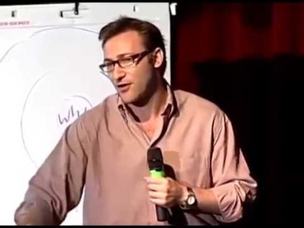
Start with Why

Slide 10
WHAT
HOW
WHY

Slide 11
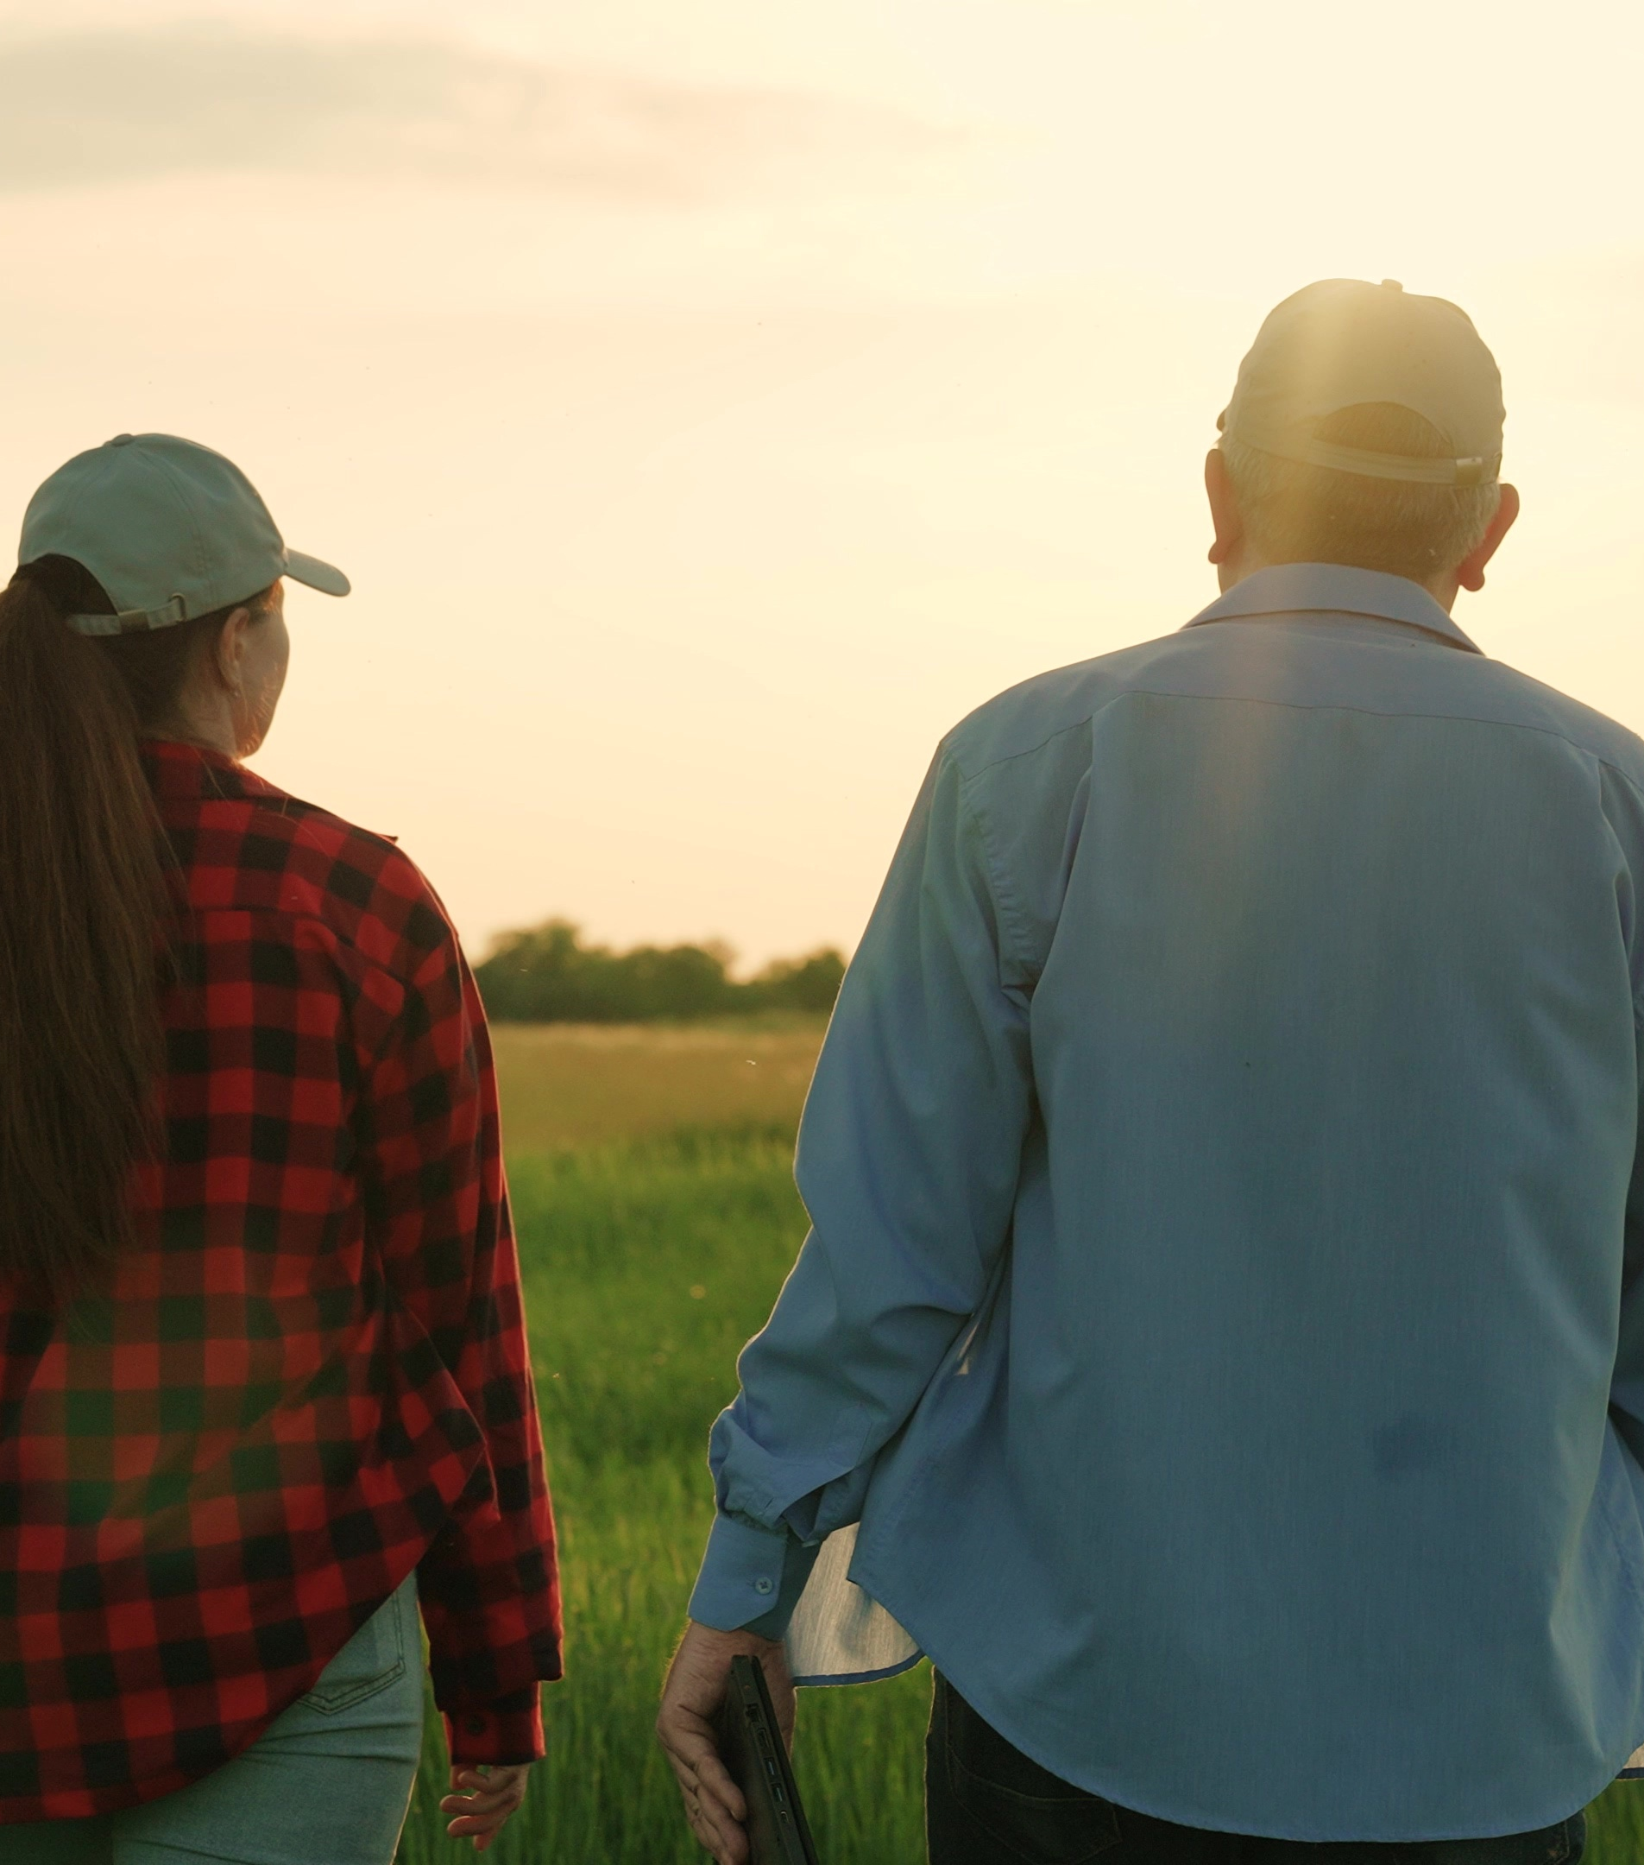
Influential Leaders
Turn to your neighbor and discuss the following:
Think about influential changemakers in the world.
Who are these leaders and what made them great?
How did they lead differently?
What strengths did they use?

Slide 12
How Do You Lead?
Executing:
Relationship Building:
How do you make things happen?
How do you build and nurture strong relationships?
Strategic Thinking:
Influencing:
How do you absorb, think about, and analyze information and situations?
How do you influence others?

Slide 13
WHAT
HOW
WHY

Slide 14
Reflection

Slide 15
Beyond ourselves-
What does this mean in the fertilizer industry?
Executing- How can you use your strengths to help the industry accomplish its goals?
Influencing- How can you influence other leaders or stakeholders within the fertilizer industry?
Strategic Thinking- How can you think strategically about situations impacting the fertilizer industry?
Relationship Building- How can you build and nurture strong relationships within the fertilizer industry?

Slide 16
Session Review
For this session, write down and post on the Green & Growing Wall:
Which session is most appealing to you? How do your strengths play a role in that perception?

Slide 17
Closing
#TFIFertilizers – share your experience on social media!

